Slide 1





INTERNATIONAL CONFERENCE
HERITAGE, CARE AND PEOPLE
Heritage networks as a sustainability strategy
27–29 May 2026
MADRID
Title
Full name
Institutional Affiliation
[Session Title]
[Institutional logo / network logo]
PID2021-127248OB-I00

Slide 2

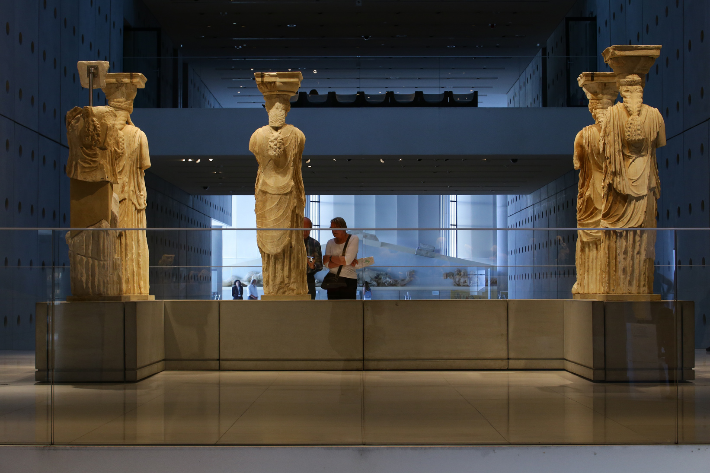
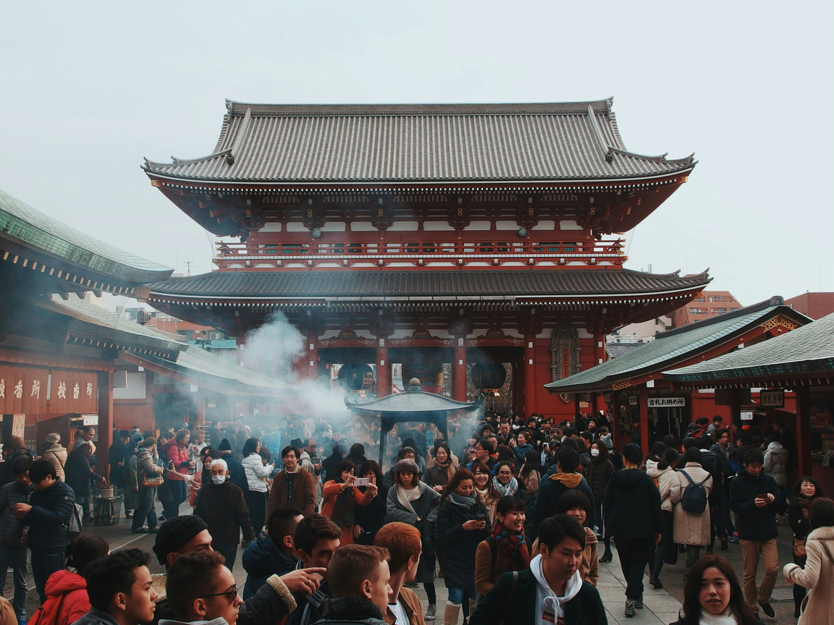
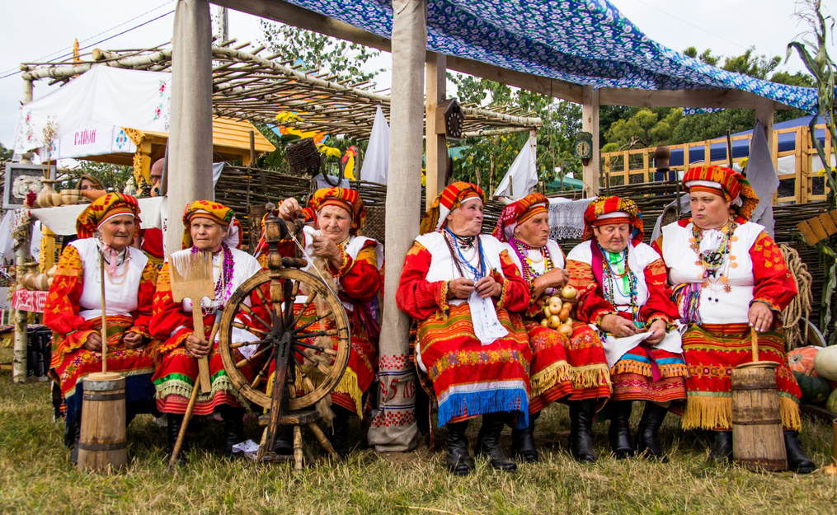
INTERNATIONAL CONFERENCE
HERITAGE, CARE AND PEOPLE
Heritage networks as a sustainability strategy
27–29 May 2026
MADRID
Title
Full name
Institutional Affiliation
PID2021-127248OB-I00
[Institutional logo / network logo]

Slide 3
Table of Contents
[Table of Contents details to be inserted here]
Paper Title | Name
Heritage, Care and People in a Resilient World
27, 28 and 29 May 2026

Slide 4
Title
[Enter text here]
Paper Title | Name
Heritage, Care and People in a Resilient World
27, 28 and 29 May 2026

Slide 5
Title
[Enter text here]
Paper Title | Name
Heritage, Care and People in a Resilient World
27, 28 and 29 May 2026

Slide 6
Title
[Enter text here]
Paper Title | Name
Heritage, Care and People in a Resilient World
27, 28 and 29 May 2026

Slide 7
Title
[Insert Figures, Tables or Images]
[Enter text here]
Paper Title | Name
Heritage, Care and People in a Resilient World
27, 28 and 29 May 2026

Slide 8
Title
[Enter text here]
Paper Title | Name
Heritage, Care and People in a Resilient World
27, 28 and 29 May 2026

Slide 9
Title
[Insert Figures, Tables or Images]
[Enter text here]
Paper Title | Name
Heritage, Care and People in a Resilient World
27, 28 and 29 May 2026

Slide 10
INTERNATIONAL CONFERENCE
HERITAGE, CARE AND PEOPLE
Heritage networks as a sustainability strategy
27–29 May 2026
MADRID
Title
Full name
Institutional Affiliation
[Institutional logo / network logo]
PID2021-127248OB-I00

