Slide 1
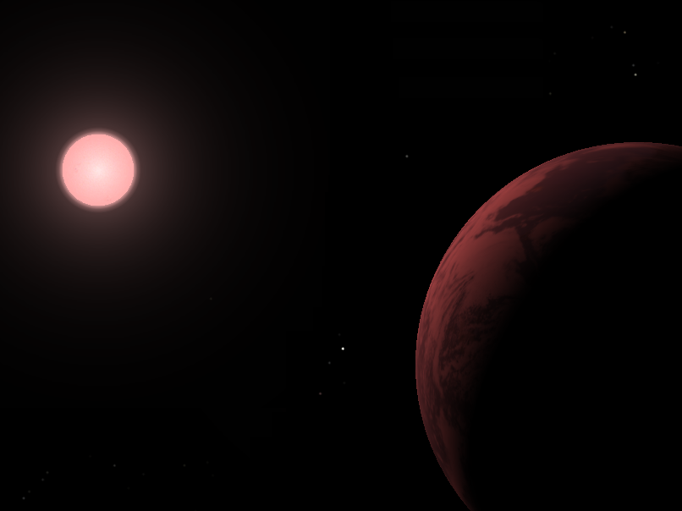
Precision Doppler spectroscopy
Guillem Anglada-Escude
School of Physics and Astronomy
Queen Mary, University of London
Institute for Astrophysics
Georg-August-Universität Göttingen
2nd CARMENES science meeting

Slide 2
Precision Doppler spectroscopy as a detection method
Indirect methods
Kinematic
Photometric
Dynamic
Gravitational
micro-lensing
Orbital perturbations
Astrometry
Timing
Doppler spectroscopy
Transit
Disk-planet interactions
Star-planet interactions

Slide 3
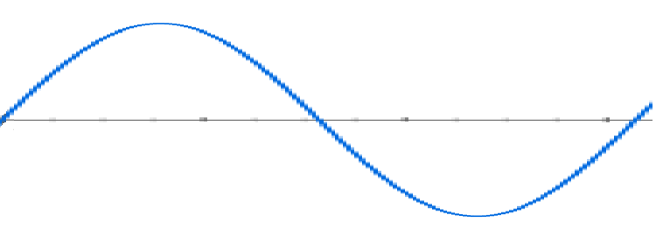
Precision Doppler spectroscopy as a detection method
α
K
RV
Time

Slide 4
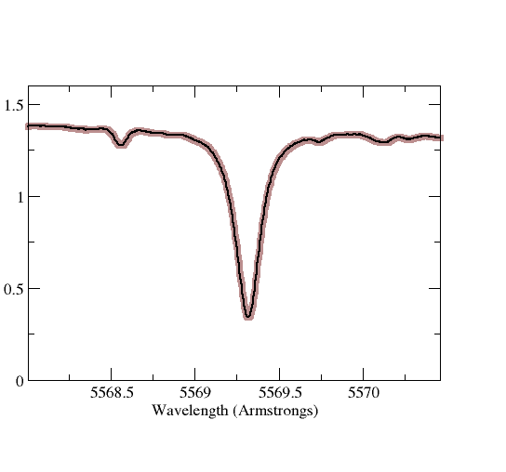
Precision Doppler spectroscopy as a detection method
Spectroscopic binary
K=30 km/s
Width of a typical solar line is 15 km/s
Hot jupiter
K=300 m/s

Slide 5
Precision Doppler spectroscopy as a detection method
0 m/s

Slide 6
Precision Doppler spectroscopy as a detection method
+ 3 m/s

Slide 7
Precision Doppler spectroscopy : (quick & unfair) historical overview
+ 3 m/s

Slide 8
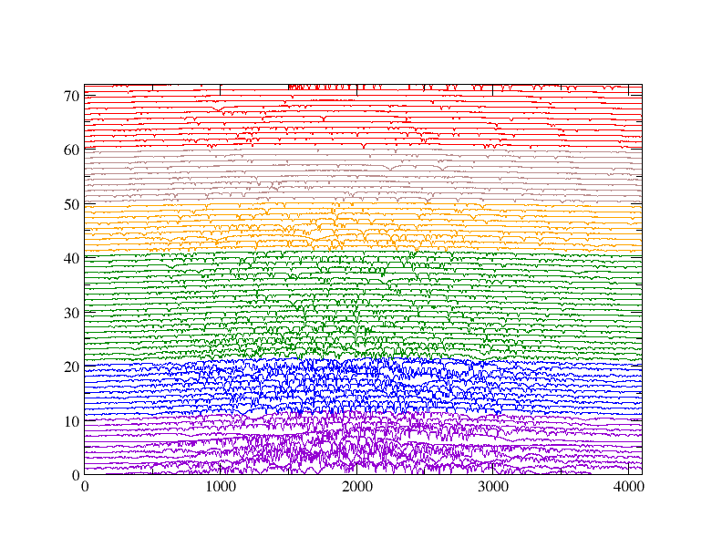
Precision Doppler spectroscopy as a detection method
Tau Ceti G8.5V
6900 A
Order
HARPS-ESO
Spectral format
3800 A
Pixel

Slide 9
Precision Doppler spectroscopy : (quick & unfair) historical overview
Stabilized spectrographs
Absorption cells
Tellurics
HF cell (CFHT)
Iodine cell - (M. Hamilton)
Warm Jupiters
50 m/s
Echelle spectrograph
+ Perforated binary mask (CORAVELs)
Digital CCF (ELODIE)
Hot jupiters
300 m/s
25 m/s
CCD
Computers
5 m/s
10 m/s
Dedicated ultra-stable
(HARPS-ESO)
Sub-Neptune
Large telescopes
(HIRES-Keck)
Sub-Neptune
3 m/s
4 m/s
NextGen CCDs
1 m/s
Dedicated semi-stabilized
(PFS-Magellan)
Few Earth masses
Software, Pipelining + calibration
<1 m/s
G, K dwarfs
Few Earth masses
2 m/s

Slide 10
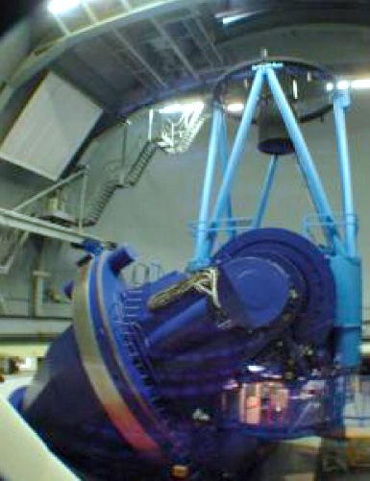
Absorption cell
Orders separated
Prism
Many interference orders overlapped
High incident angle Grating
Absorption cell

Slide 11
Stabilized spectrograph
Orders separated
Prism
Many interference orders overlaping
High incident angle Grating

Slide 12
Stabilized spectrograph
Orders separated
Prism
Many interference orders overlaping
High incident angle Grating
Fiber – light transport + scrambling

Slide 13
Precision Doppler spectroscopy : (quick & unfair) historical overview
Exo-Jupiter formula
G dwarf
HZ @ 1 AU
M dwarf
HZ @ 0.1 AU
30 m/s
950 m/s
500+ planets
ELODIE, Hamilton, HIRES/Keck, CORALIE, HARPS, UVES/VLT, AAT …
Exo-Earth formula
0.1 m/s
3.1 m/s
Happening now…
HARPS, PFS/Magellan, HIRES/Keck

Slide 14
Precision Doppler spectroscopy : (quick & unfair) historical overview
Absorption cells
Tellurics
HF cell (CFHT)
Iodine cell - (M. Hamilton)
Warm Jupiters
Large telescopes
(HIRES-Keck)
Sub-Neptune
Dedicated semi-stabilized
(PFS-Magellan)
Few Earth masses
50 m/s
25 m/s
5 m/s
Infrared (~2000)
First high-res spectrographs
(CSHELL-IRTF, 256x256 pixels)
100 m/s
4 m/s
Echelle – low resolution
(Tellurics-NIRSPEC)
High resolution – Large telescopes (CRIRES)
50 m/s
Absorption cells
6 m/s
New large format arrays, nIR cross dispersion, stabilized cryogenic optics…
2 m/s

Slide 15
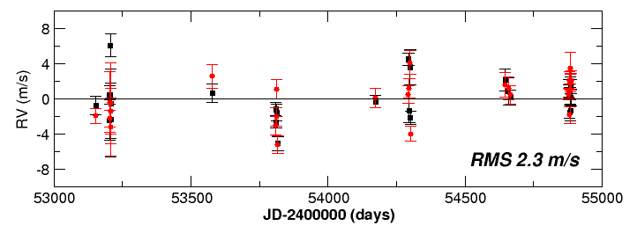
M-dwarfs : Radial velocities in the near infrared?
RMS 5.4 m/s
Proxima Cen, CRIRES/VLT with Ammonia
Bean et al. ApJ 2010
RMS 2.3 m/s
Proxima Cen, HARPS/3.5m

Slide 16
Absorption cell (optical and nIR) vs Stabilized spectrographs (optical)
Absorption cell technique
Stabilized spectrograph
Requires an absorption cell
External calibration source (ThAr)
Precision limited by PSF
Stabilized PSF
Works on any spectrograph
Specialized spectrograph
No-cell templates are critical
High SNR templates
Available on several instruments
Built only by Geneva group
Very complex software.
Private data reduction pipelines
Proprietary instruments & Data reduction pipelines …
But (some) HARPS data is public!
& CARMENES!

Slide 17
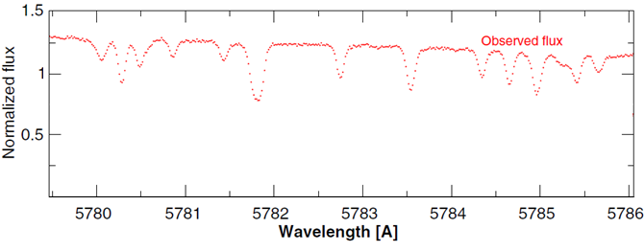
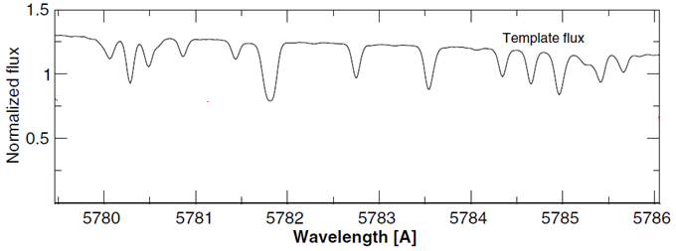
Doppler measurement
Observed spectrum
Ideal template of the star
f_{i} i=1,…N_{obs}
F(kλ)

Slide 18
Doppler measurement
Most simple case : Only Doppler offset
$$R_{i}=f_{i}−F\left(kλ_{i}\right)$$

Slide 19
Doppler measurement
Most simple case : Only Doppler offset
$$R_{i}=f_{i}−F\left(kλ_{i}\right)$$
A bit better: Doppler offset +
flux scaling
$$R_{i}={a_{0}f}_{i}−F\left(kλ_{i}\right)$$

Slide 20
Doppler measurement
Most simple case : Only Doppler offset
$$R_{i}=f_{i}−F\left(kλ_{i}\right)$$
Even better : Polynomial flux correction
n
$$R_{i}={(a_{0}+a_{1}λ_{i}+…a_{n}λ_{i})f}_{i}−F\left(kλ_{i}\right)$$

Slide 21
Doppler measurement
$$R_{i}=\frac{(a_{0}+a_{1}λ_{i}+…a_{1}λ_{i})f_{i}−F\left(kλ_{i}\right)}{σ_{i}}$$
$$\sum_{i}{R_{i}^{}}$$
2
$$χ^{2}\left[a_{0},…,a_{n}, k\right]=$$

Slide 22
Doppler measurement
$$\frac{∂χ^{2}}{∂a_{0}}=0$$
Preferred solver
(and interpolator)
$$\frac{∂χ^{2}}{∂a_{n}}=0$$
$$χ^{2}$$
min
$$\frac{∂χ^{2}}{∂k}=0$$
$$k=1−\frac{v}{c}$$

Slide 24
Doppler measurement :
and what about cross-correlation methods?
$$R_{i}=f_{i}−F\left(kλ_{i}\right)$$
$$χ^{2}=\sum_{i}{{\left(f_{i}−F\left(kλ_{i}\right)\right)}_{}^{2}}$$

Slide 25
Doppler measurement :
and what about cross-correlation methods?
$$χ^{2}=\sum_{i}{f_{i}+F\left(kλ_{i}\right)−{2f}_{i}F\left(kλ_{i}\right)}$$
2
2

Slide 26
Doppler measurement :
and what about cross-correlation methods?
$$\frac{∂}{∂k}χ^{2}=\frac{∂}{∂k}\sum_{i}{f_{i}}+\frac{∂}{∂k}\sum_{i}{F\left(kλ_{i}\right)}−2\frac{∂}{∂k}\sum_{i}{f_{i}F\left(kλ_{i}\right)}$$
2
2

Slide 27
Doppler measurement :
and what about cross-correlation methods?
$$\frac{∂}{∂k}χ^{2}=\frac{∂}{∂k}\sum_{i}{f_{i}}+\frac{∂}{∂k}\sum_{i}{F\left(kλ_{i}\right)}−2\frac{∂}{∂k}\sum_{i}{f_{i}F\left(kλ_{i}\right)}$$
2
2

Slide 28
Doppler measurement :
and what about cross-correlation methods?
$$\frac{∂}{∂k}χ^{2}=−2\frac{∂}{∂k}\sum_{i}{f_{i}F\left(kλ_{i}\right)}=0$$

Slide 29
Cross-correlation with binary mask (weighted)
Cross Correlation Function (CCF)
D. Queloz, Proc. IAU Symposium 1995
CCF
1
λ
0
-30
-20
-10
0
10
20
30
RV offset (km/s)
Proxima Cen

Slide 30
Mask CCF in M dwarfs?
Tau Ceti
G8.5V
OK!
Barnard’s
M4V
?
?
?
?
?
?
?
?
?
?
?
?
?
?
?
?
?
?
?
?
?
?
?
?
?
?

Slide 31
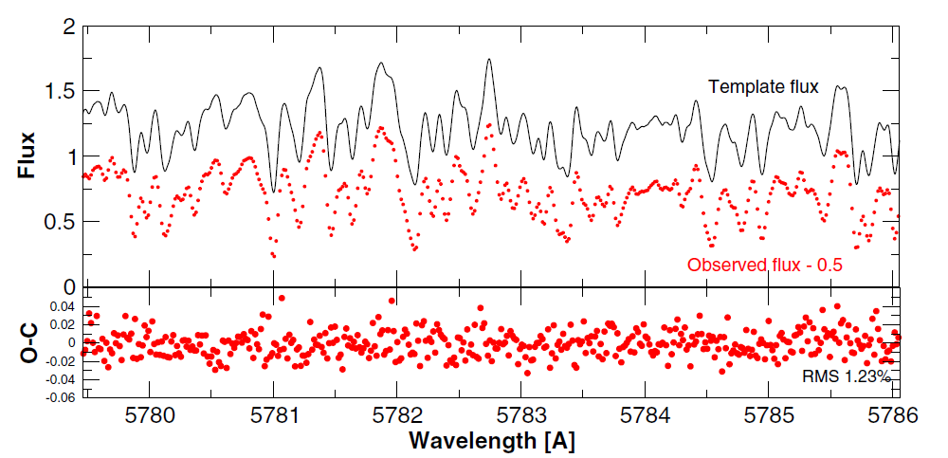
Least-squares matching is much better!
Barnard’s star, M4V

Slide 32
Least-squares matching is much better!
Barnard’s star, M4V

Slide 33
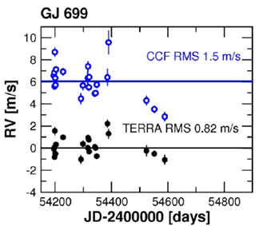
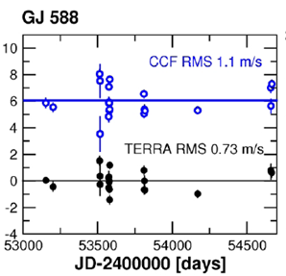
Some M-dwarfs are more stable than G and K dwarfs!
2.6%
Perspective acceleration effect
Zechmeister et al. 2009 A&A

Slide 34
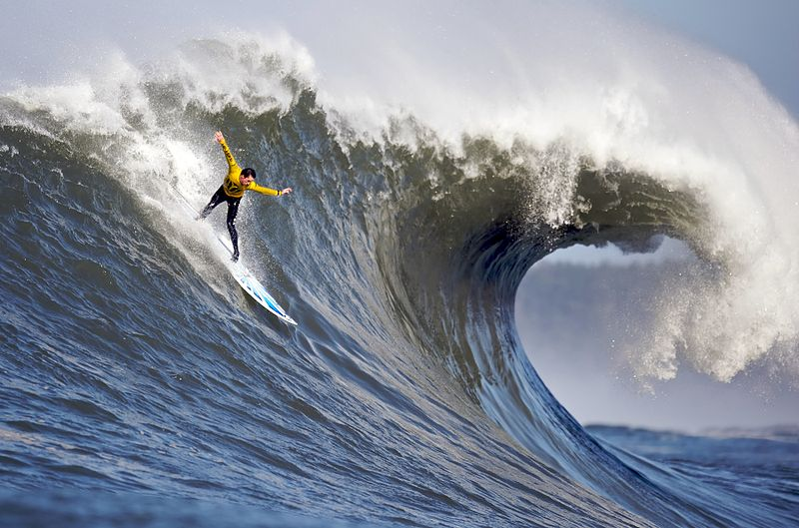
Some M-dwarfs are more stable than G and K dwarfs!
2.6%
Perspective acceleration effect
Zechmeister et al. 2009 A&A
Now we are surfing the photon noise!

Slide 35
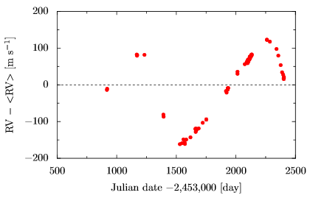
We got RV, now what?

Slide 36
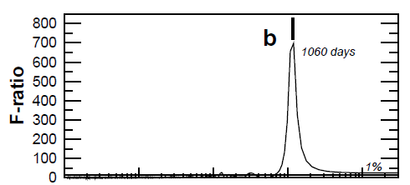
Toolbox : periodograms
$$F_{P}=\frac{χ^{2}−χ^{2} /(k−k )}{χ^{2}/(N_{obs}−k)}$$
P
null
P
null
P
P

Slide 37
Toolbox : periodograms
$$ΔlnL=lnL−lnL$$
P
null
More detailed/correct discussion see:
Baluev 2009 & 2012
(his codes are public!)
2
$$L=\prod_{i}{\frac{1}{\sqrt{2π(σ^{2}+s^{2})}} exp\left[−\frac{1}{2}\frac{\left(v_{i}−v\left(t_{i};θ\right)\right)}{σ^{2}+s^{2}}\right]}$$
i
i
$$lnL=−\frac{N}{2}\ln\left(2π\right)−\frac{1}{2}\sum_{i}{\ln\left(σ^{2}+s^{2}\right)}−\frac{1}{2}\sum_{i}{χ^{2}}$$
i

Slide 38
Toolbox : periodograms
$$ΔlnL=lnL−lnL$$
P
null

Slide 39
Toolbox : periodograms
$$ΔlnL=lnL−lnL$$
P
null
M sin i = 11.0 M_{earth}
RMS 1.6 m/s
M sin i = 4.4 M_{earth}

Slide 40
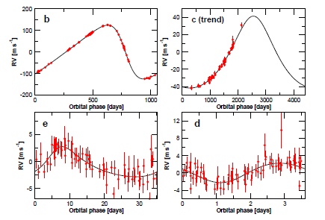
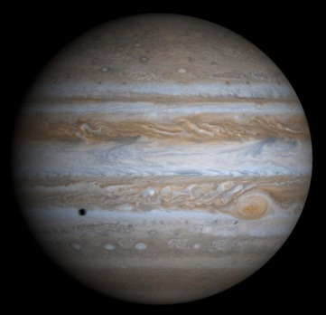
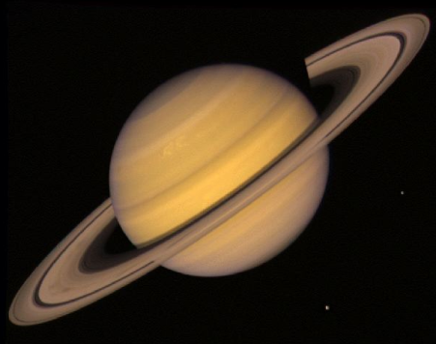
Multiplanet system!
GJ 676A, M0V
2 gas giants
+1 hot Neptune
+1 very hot super-Earth
Anglada-Escude & Tuomi, 2012 A&A
5.2 AU
1.8 AU
0.041 AU
0.187 AU

Slide 41
Toolbox : Bayesian MCMC
Likelihood function
$$L∝EXP\left[− \frac{1}{2}χ^{2}\right]$$
Mass
Period

Slide 42
Toolbox : Bayesian MCMC
Provides optimal sampling in highly dimensional spaces
N = 3 + 5 x Nplanets
Likelihood function
$$L∝EXP\left[− \frac{1}{2}χ^{2}\right]$$
Run a few million steps and you are done!
Mass
Period

Slide 43
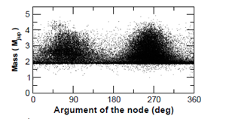
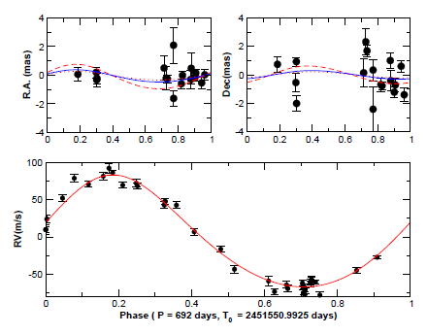
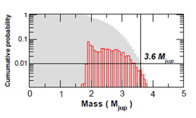
Toolbox : Bayesian MCMC
Combined constrains
Example : GJ 317
astrometry +
radial velocity

Slide 44
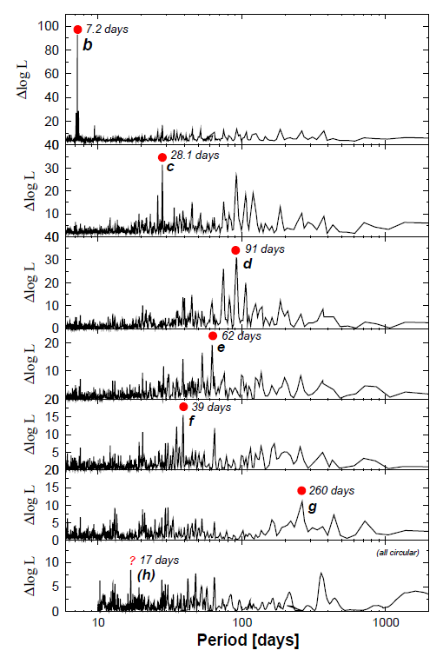
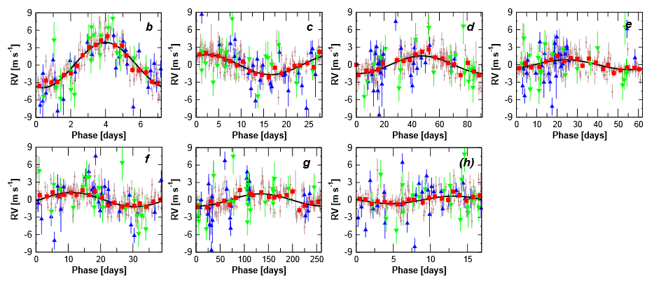
Periodograms + Bayesian + dynamics + priors + attempts to model red noise

Slide 45
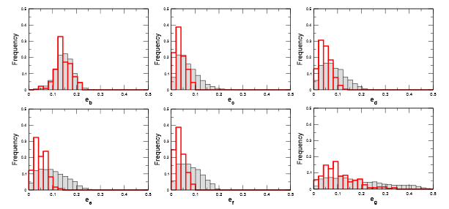
Periodograms + Bayesian + dynamics + priors + attempts to model red noise
Applying dynamical stability prior
g
d
f
e
c
b

Slide 46
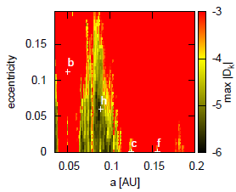
Periodograms + Bayesian + dynamics + priors + attempts to model red noise
c
(h)
b

Slide 47
Take home message
Understand your instrument AND YOUR DATA
Learn how to design your model optimization scheme
Get trained into basic data analysis techniques. Take a course if necessary
Think further :
Bayesian RV measuring algorithm?
How can I measure line shapes? (e.g. bisector-like indices)
How to incorporate activity information into the Doppler model?
Find collaborators to take care of thinks you don’t have time to learn (e.g. dynamics!) or do (TRANSIT SEARCHES, anybody in charge???)
Be skeptic of black-boxes.
If you can code it, you master it.

